Slide 1

Capstone Project: Sakila Movie Rental Analytics
Power BI | SQL | Excel Project

Slide 2
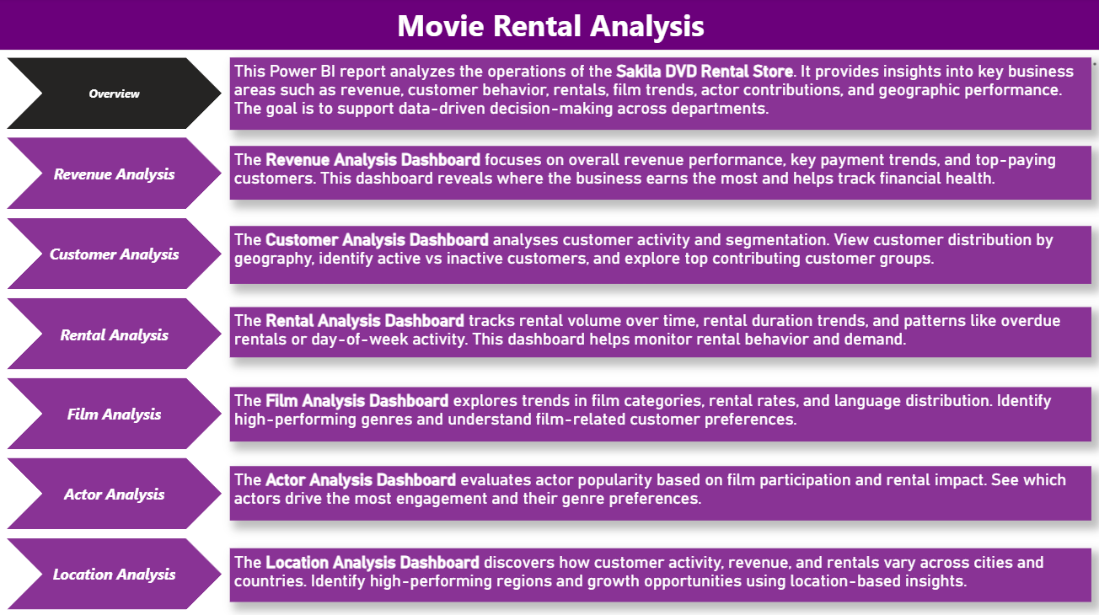

Slide 3




Objective: The objective of this project is to develop a comprehensive data analytics solution using the Sakila Movie Rental database. Through the use of SQL for data extraction, Excel for exploratory data analysis (EDA), and Power BI for visualization and dashboarding, the project aims to uncover actionable insights related to customer engagement, rental behavior, film performance, actor contribution, and regional store operations. These insights are designed to support strategic decisions and enhance overall business efficiency in a highly competitive media rental environment.
Analysis Scope: The analysis explores multiple dimensions of Sakila’s operations, including customer segmentation, rental frequency patterns, genre preferences, film inventory characteristics, actor popularity, and store-level performance across global locations. Using transactional and master data, relationships are modeled to reveal usage trends, demographic influences, and category-level profitability, thus providing a well-rounded view of the company’s business dynamics.
Goal: The goal of the project is to deliver an interactive, MECE-structured analytics framework that equips business stakeholders with the tools to monitor KPIs, identify trends, and make informed decisions. By combining statistical exploration with intuitive visuals, the solution enables management to optimize film offerings, retain high-value customers, improve content strategy, and drive performance across different geographies—ultimately leading to sustainable growth and improved customer satisfaction.

Slide 4
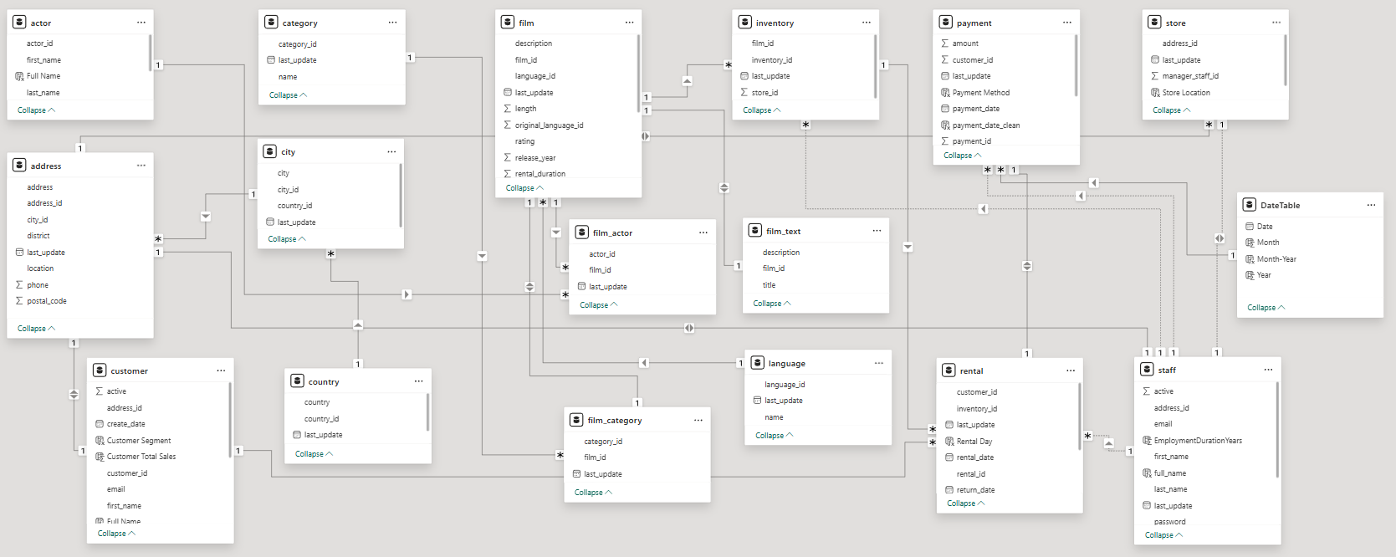
ER Diagram

Slide 5
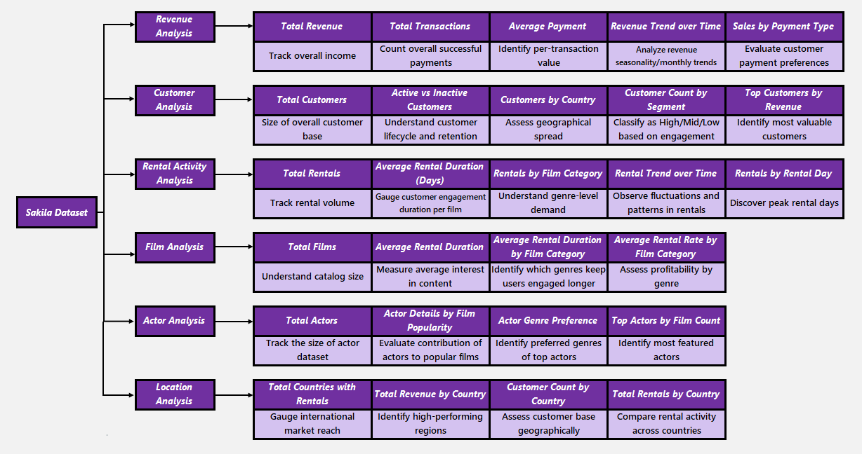
MECE Breakdown

Slide 6
Power BI Dashboard

Slide 7
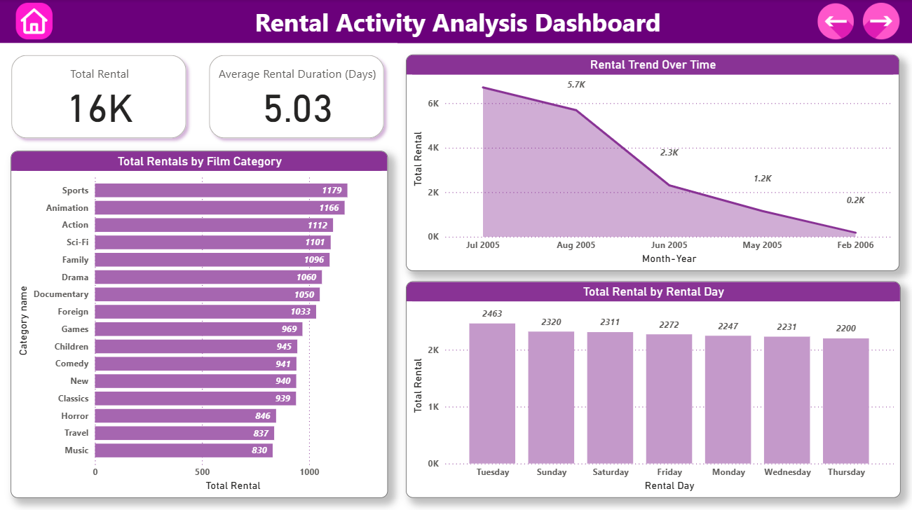

Slide 8
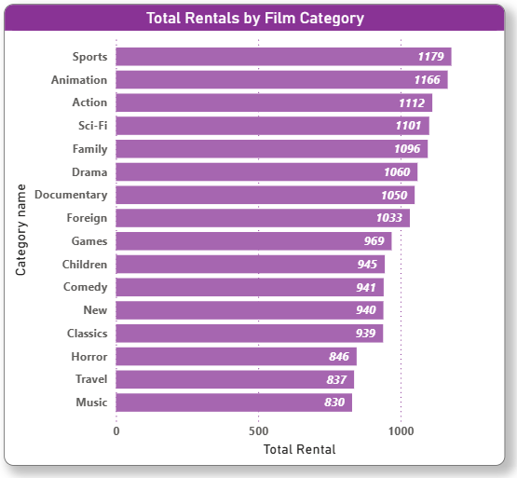
Problem Statement: Which film genres are rented the most?
Analysis:
A bar chart displays rental volume across categories like Action, Comedy, Sci-Fi, etc.
Helps identify high-demand genres.
Indicates customer preferences and content trends.
Informs purchase decisions and marketing prioritization for new films.
This analysis supports better content acquisition and personalization.

Slide 9
Exploratory Data Analysis (EDA)

Slide 10
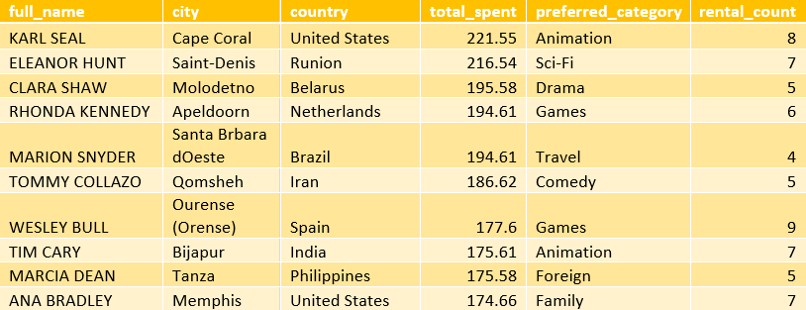
Problem Statement: What are the demographics and preferences of the highest-spending customers?
Result Table:
Analysis:
Profiling the top 10 customers by total spend shows that they span across various cities and countries, but share certain patterns:
Preferred categories include Animation, Sci-Fi, and Drama, indicating content appeal.
Most top spenders made 5–9 rentals, highlighting repeat behaviour.
This supports customer targeting, loyalty tracking, and is further visualized in the Customer & Location dashboards.

Slide 11
Key Insights
High-loyalty and mid-loyalty customers consistently generated the highest monthly revenues.
Certain categories like Sci-Fi and Animation were rented for longer, indicating deeper engagement with these genres.
Overwhelmingly preferred English films—highlighting a lack of language diversity in content offerings.
Different age groups preferred different genres: Teens leaned toward Action and Sports, Seniors preferred Animation and Drama, while Adults showed a balanced mix.
Countries like the United States, India, and Brazil contributed the highest revenue and rental activity.
A small group of top-spending customers contributed significantly more than the average customer.

Slide 12
Thank You

